Slide 1
109學年實驗教育表達力課程
自我行銷與魅力表達高效率簡報製作
國立基隆商工商業經營科團隊
基隆市立南榮國民中學

Slide 3
課程緣起
溝通力
01
由基礎站、坐姿開始，善用肢體語言，強化表達與應對的溝通能力。
目標力
02
透過實務個案，了解需求與目標，擬定說服策略。
邏輯力
03
運用簡報架構，提升學生邏輯思考與表達能力。
自信力
04
克服恐懼、展現自信與影響力。

Slide 4
課程內容
母片設計一點通
視覺呈現大哉問
動畫效果一籮筐
影音效果真美妙
成果發表

Slide 5
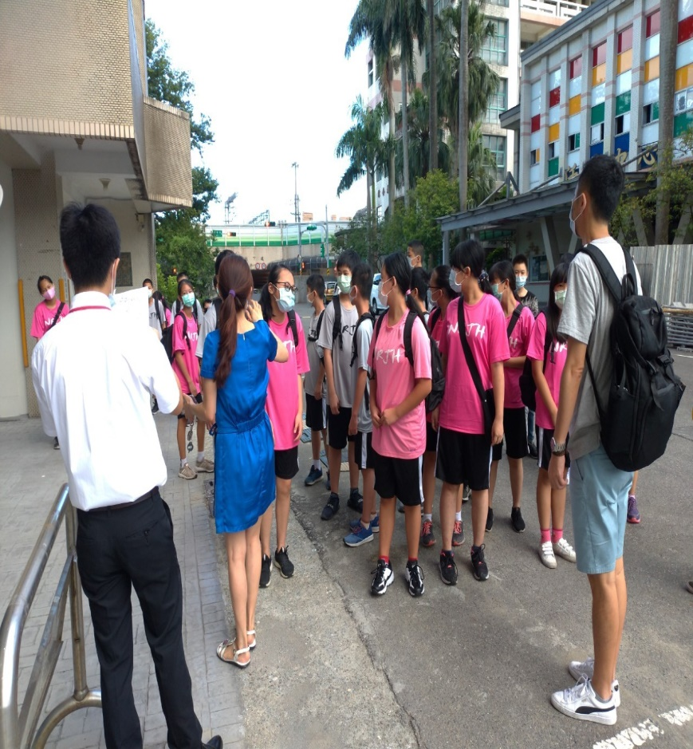
基商商工商業經營科潘主任學生分組
You can simply impress your audience and add a unique zing and appeal to your Presentations. Easy to change colors, photos and Text. Get a modern PowerPoint Presentation that is beautifully designed. You can simply impress your audience and add a unique zing and appeal to your Presentations. You can simply impress your audience and add a unique zing and appeal to your Presentations. Easy to change colors, photos and Text. You can simply impress your audience and add a unique zing and appeal to your Presentations. Easy to change colors, photos and Text.

Slide 6
基商商經科最優質小隊輔
猜最左後方的是誰?
帥哥美女照過來
有你們真好！謝謝

Slide 7
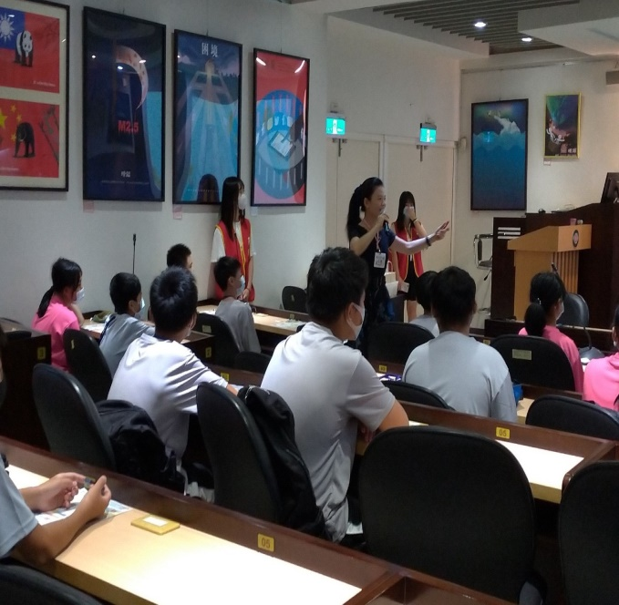
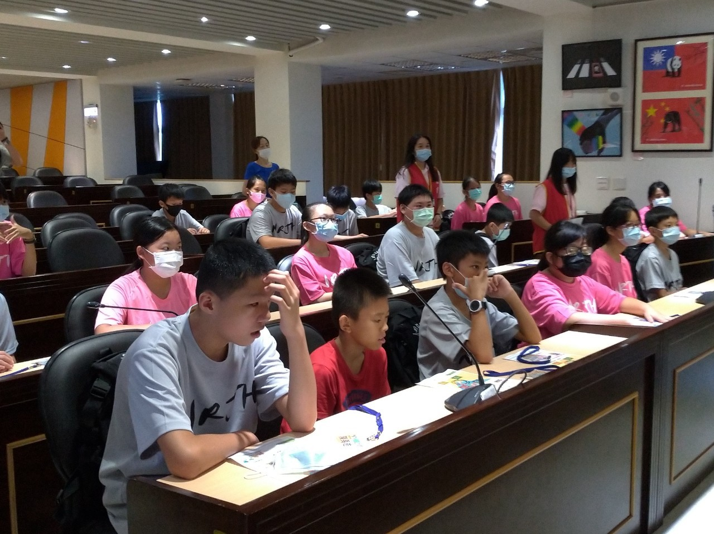
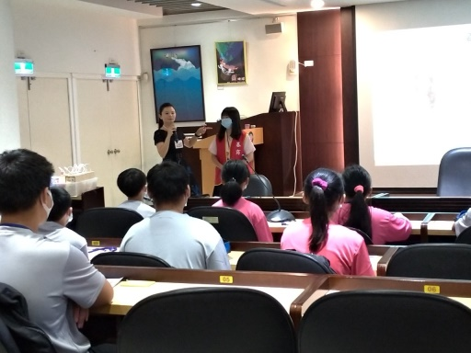
Get a modern PowerPoint Presentation that is beautifully designed.
自在表達 成功溝通
是 自信心 的關鍵
Your Content Here
You can simply impress your audience and add a unique zing and appeal to your Presentations. I hope and I believe that this Template will your Time, Money and Reputation.
Get a modern PowerPoint Presentation that is beautifully designed. You can simply impress your audience and add a unique zing and appeal to your Presentations.
Easy to change colors, photos and Text. I hope and I believe that this Template will your Time, Money and Reputation. Get a modern PowerPoint Presentation that is beautifully designed.
You can simply impress your audience and add a unique zing and appeal to your Presentations.
Get a modern PowerPoint Presentation that is beautifully designed.

Slide 8
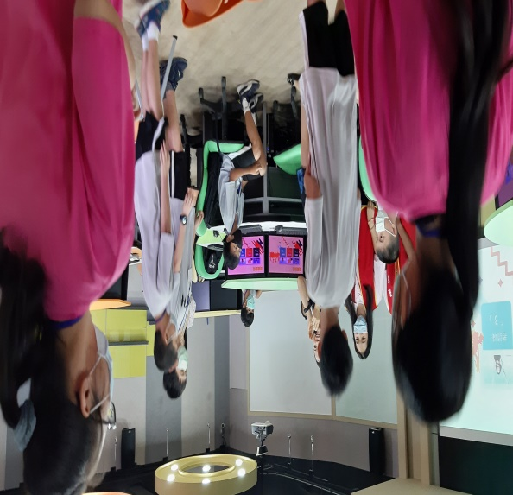
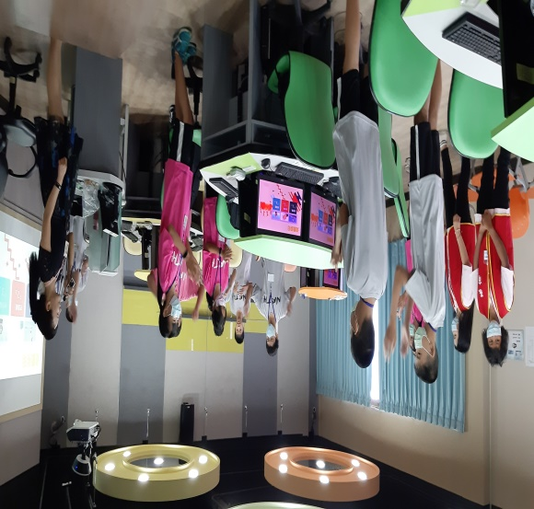
愛的溝通-傾聽 興趣 認同 鼓勵

Slide 9
你可以決定你的姿勢 你就能決定你是誰
姿勢決定你是誰
良好的姿勢 是自信 的第一步

Slide 10
動畫效果一籮筐
三星SMART簡報製作

Slide 11
影音效果真美妙

Slide 12
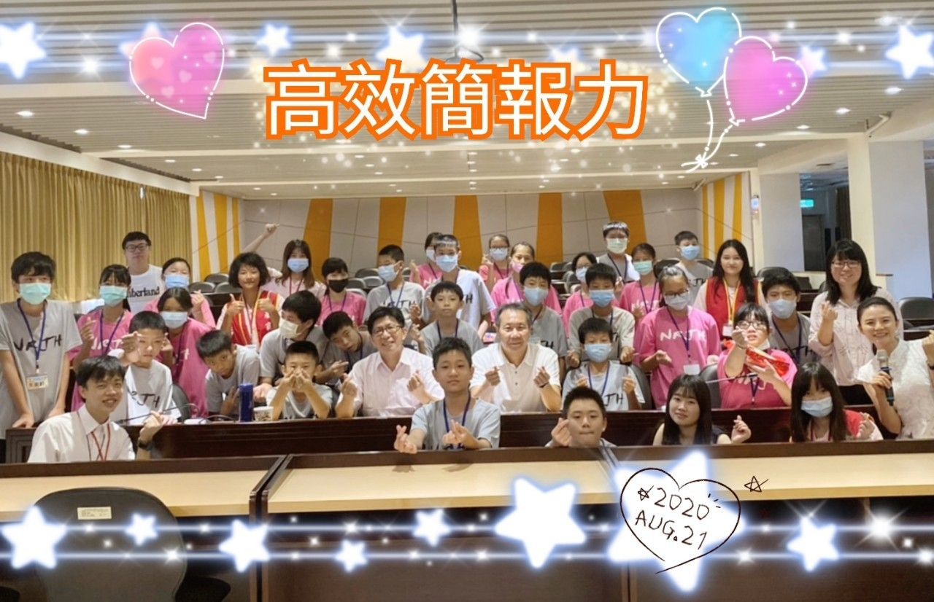
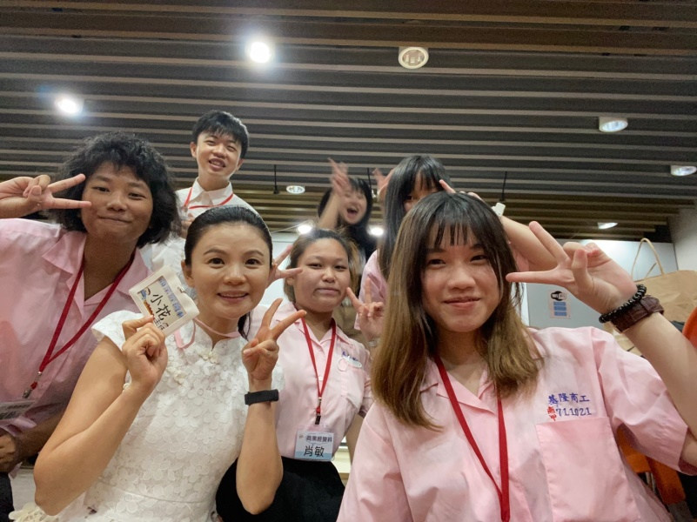
高效簡報力 成果展
讓未來的你 透過高效簡報力而來臨

Slide 13
星光大道-表達力明日之星
第二名
洪校長頒獎
再接再勵

Slide 14
星光點點獎
財務分析報告
部門財務報告
部門財務盈虧

Slide 15
星光點點獎
市佔率分析
學姐出馬
產品簡介

